Slide 1
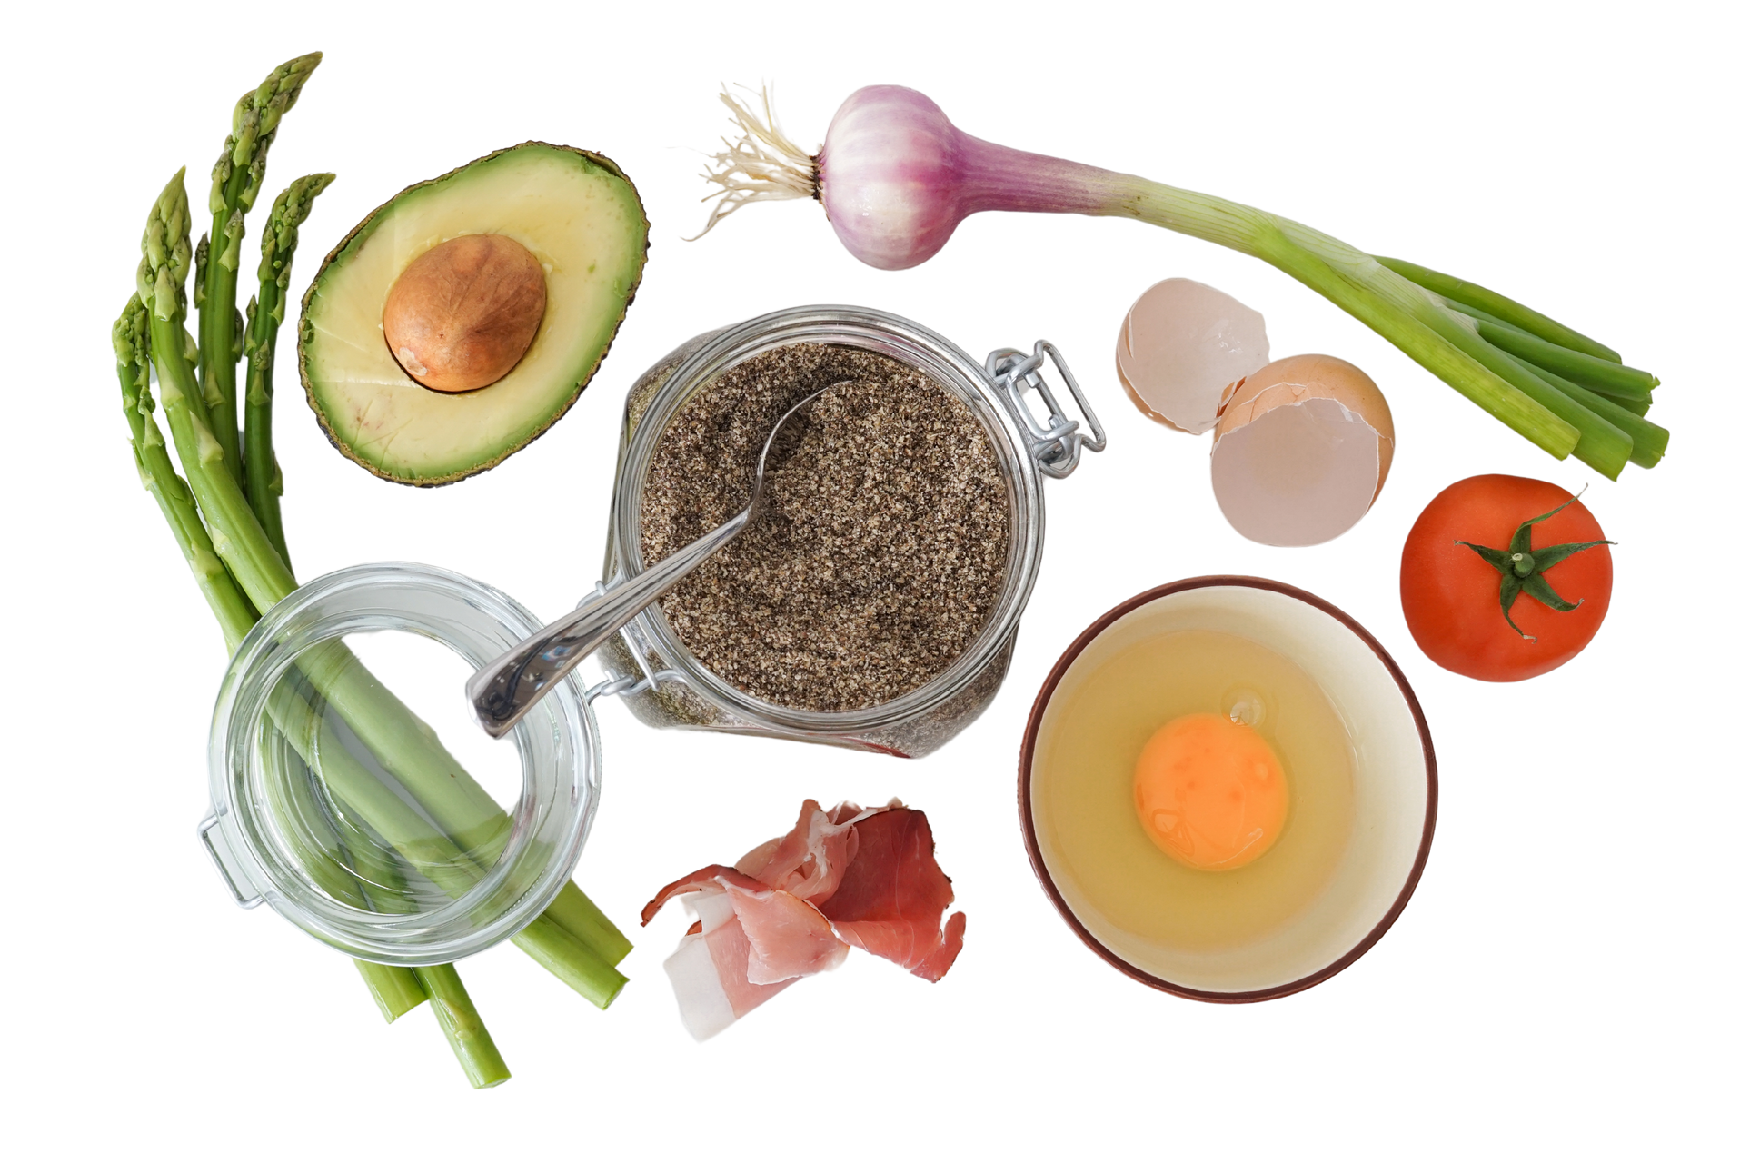

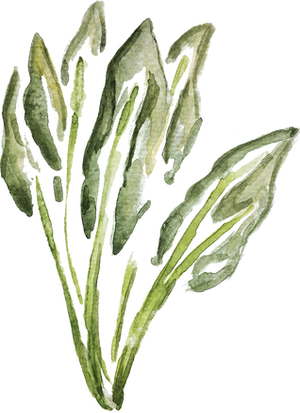

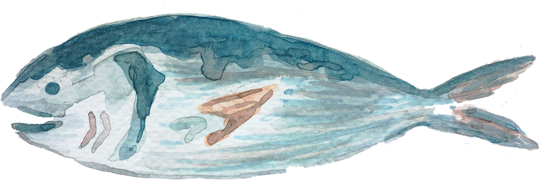
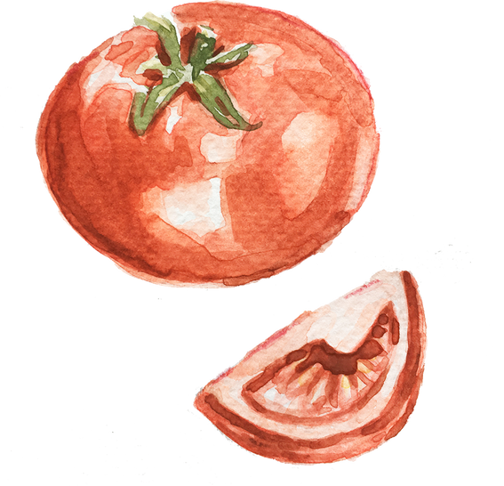

Addison Neise
Cory Daut
Dan Prather
Jillian Brodeur
USDA FOOD & NUTRIENT ANALYSIS

Slide 2



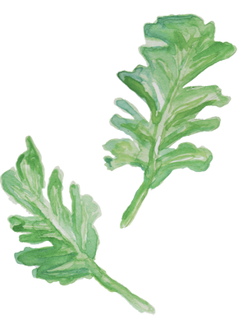
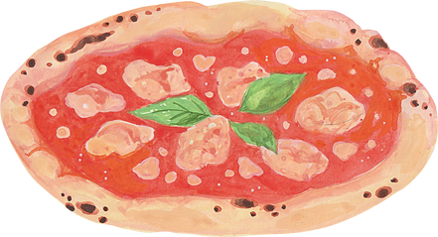
Analysis
As USDA FoodData Central continues to experience a decline in resources for food and nutrient analysis. We are researching a more concise set of foods that will be necessary to continue to evaluate, creating a decline in spending.

Slide 3
Challenges
Understanding the Dataset.
Navigating missing data.
Choosing the best procedure for comparing the two methods.

Slide 4
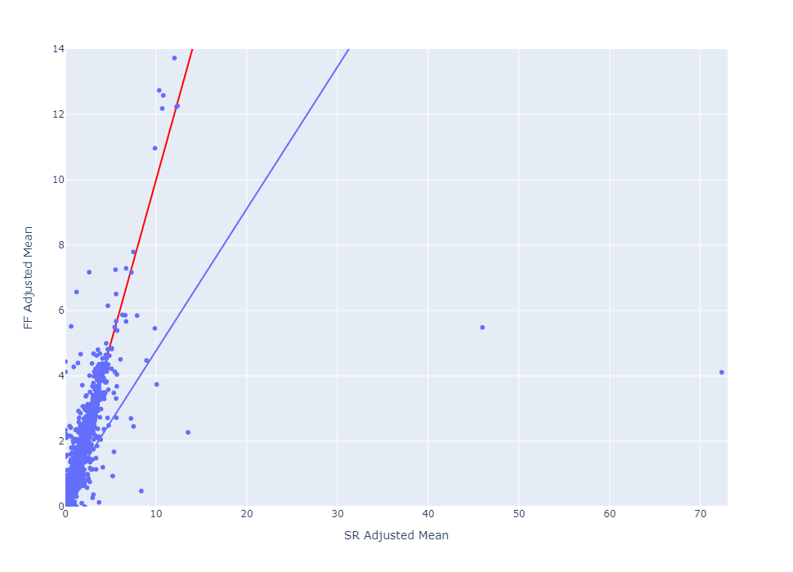
By comparing the means of each nutrient in the dataset, we can see how the methods used to determine nutrient value compare.
A 1:1 ratio (designated by the red line) implies a perfect match.
Notes:
annual?

Slide 5
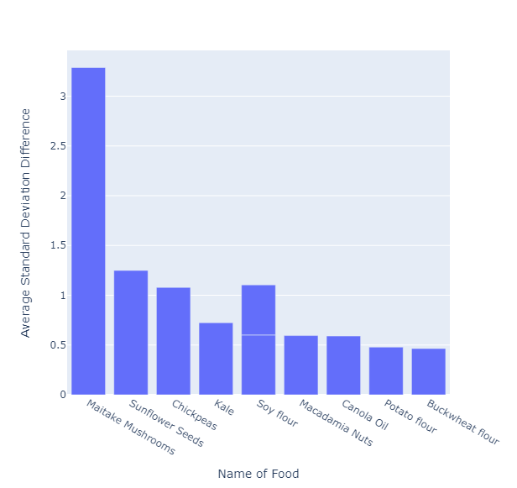
Foods that their Nutrient Values Have
Changed
Notes:
maitake mushrooms:
effective in treating certain illnesses
using maitake mushrooms in cancer research
useful in treating cold and flu, high and low blood pressure, immune function, and side effects of chemotherapy
maitake mushrooms are said to have an effect on blood sugar and it may lower blood pressure
large effects:
allergic reactions - these are more common in whole mushroom products rather than the extracts
digestive issues - this is said to occur when the mushrooms are raw or undercooked
blood sugar interactions
blood-thinning effects
immune system modulation
Sunflowers:
help lowers blood pressure, cholesterol and blood sugar
short term inflammation
research is being done on blood sugar and type two diabetes
Chickpeas:
regulation of blood pressure and blood sugar
research on chickpeas improving heart health
Canola oil:
impact on heart health
canola oil is modeled as a heart-healthy fat, but there has been evidence that suggests
olive oil has a much better impact on lower blood levels

Slide 6
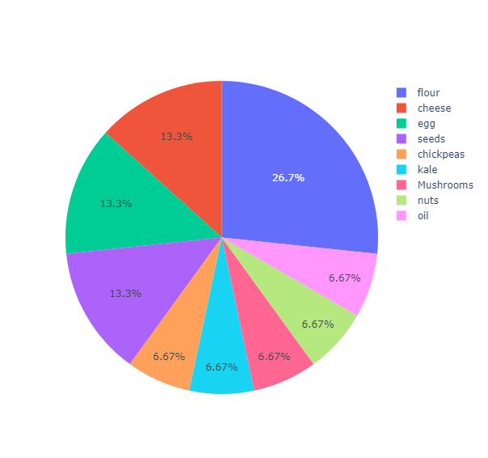
Flour makes up the majority of foods that require reevaluation
Notes:
flours:
FDA and Centers for Disease Control and Prevention have investigated
several outbreaks of foodborne illnesses
the bacteria Salmonella was caused food poisoning which have caused mild to serious symptoms
Flours made directly from raw grains can be exposed to bacteria in the field or when the flour is being made
processing raw grains into flour does not kill bacteria

Slide 7
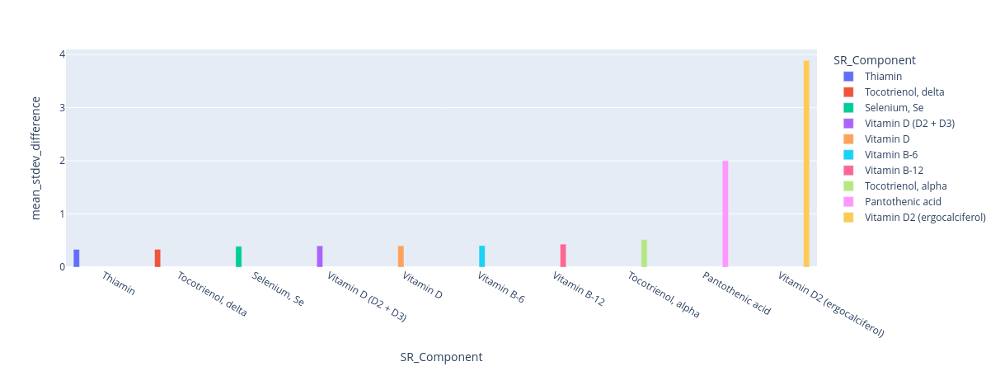
The amount of Vitamin D2 in each food
fluctuates the most between the two methods.
Mean Deviation Difference
SR Component
Notes:
annual?

Slide 8
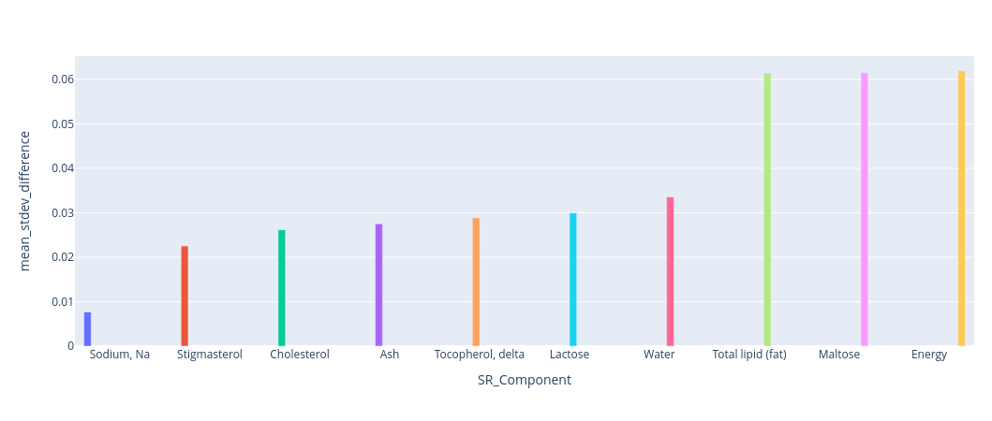
Stable Nutrients
Mean Deviation Difference
SR Component
Notes:
annual?

Slide 9
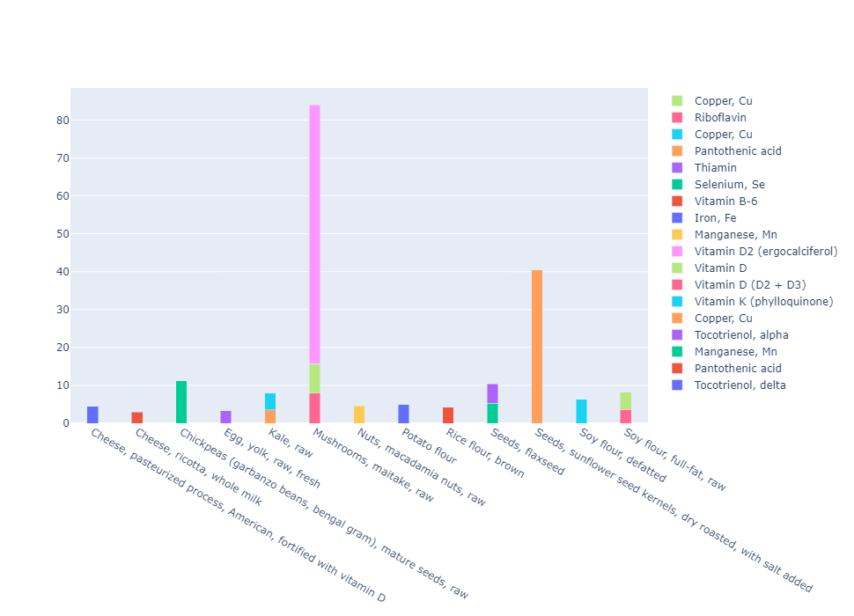
Problem Foods and their Respective Nutrients
Notes:
annual?

Slide 10

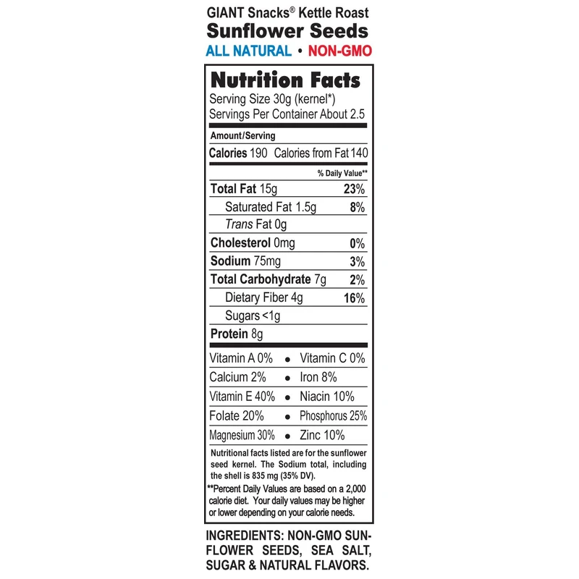
Why it Matters
Manufactured food labels
Informed consumer
Truthful advertising
Health and wellness

Slide 11
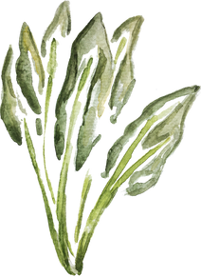
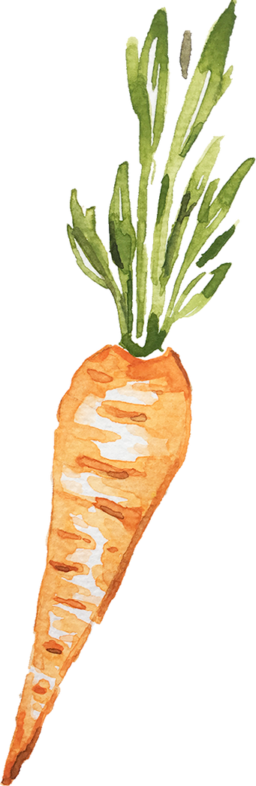
Why it Matters
Agricultural development
“To promote agriculture production that better nourishes Americans while also helping feed others throughout the world”
-About USDA Website

Slide 12
Conclusion
Top foods that FDC should analyze further:
Maitake Mushrooms
Sunflower Seeds
Chickpeas
Kale
Soy Flour

Slide 13
Questions?

Slide 14
Outside Sources
https://www.fda.gov/consumers/consumer-updates/flour-raw-food-and-other-safety-facts
https://www.healthline.com/health/food-nutrition/maitake-mushroom

